Slide 1


Mini Project (CSE7102)
REVIEW-1
29-08-2026
Presidency
School of Computer Science and Engineering

Slide 2
Flood Prediction using GIS and Machine Learning
CSS7102- Mini Project Review-1
Project ID: PRJ_363
Panel No: PANEL-26
Group members details:
Under the Supervision of,
Ms. Pathan Tasneem Farhana
Assistant Professor
School of Computer Science and Engineering
Presidency University
Sl.No | Student Name | Roll Number
1 | Sagar. P | 20221COM0119
2 | Duddukuri Sri Aditya | 20221COM0087
3 | Veluru Rahul | 20231CSN0053
Name of the Program(s): B.Tech - Computer Science and Engineering
Name of the HoD (Team Leader’s): Dr. Gopal K Shya
Name of the Program Project Coordinator (Team Leader’s): Ms. Sumita Guddin
Name of the School Project Coordinators: Mr. Muthuraju V

Slide 3
INDEX
Problem Statement
Git Hub Link
Introduction
Literature Review
Architecture Diagram
Analysis of Problem Statement/Output Expected
Timeline of the Project(Gantt Chart)
References

Slide 4
Problem Statement Number: PRJ_363
Category (Hardware / Software / Both): Software (Machine Learning, GIS)
Problem Description:
A solution designed to address urban flood prediction and alert system using machine learning and GIS to improve efficiency, decision-making, monitoring, automation, and user outcomes.
Difficulty Level: Medium

Slide 5
Github Link
The Github link provided should have public access permission.
https://github.com/<team>/flood-prediction-gis-ml (to be created before final submission; ensure public access)

Slide 6
Introduction
About the project:
Problem: Urban flooding is increasingly difficult to predict due to heavy rainfall, poor drainage, rapid urbanization, and changing land use. Traditional flood-warning methods often fail to provide localized, timely predictions.
Proposed Solution: A GIS-integrated machine learning framework that combines rainfall, elevation, drainage, land-use, and soil data to predict urban flood risk, classify areas by risk level, and generate real-time alerts when dangerous conditions are detected.

Slide 7
Literature Review
A review of 11 recent papers on urban flood prediction using GIS and machine learning is summarized below.
# | Source (Authors, Venue, Year) | Key Contribution
1 | Environmental Systems Research (Springer), 2025 | Reviews the evolution from physical process-based flood models to ML approaches integrated with GIS, IoT, and community participation.
2 | Motta, de Castro Neto & Sarmento, IJDRR, 2021 | Combines an ML classifier with GIS statistics; Random Forest gave the best result (MCC 0.77) using limited sensing data.
3 | Science China Technological Sciences, 2025 | ML+GIS framework predicts flood susceptibility of urban metro systems; validated on the Zhengzhou 7.20 flood event.
4 | ScienceDirect, 2026 | Integrates land-use simulation, morphology analysis and ML (PLUS-MSPA-HGBDT) to assess future urban flood susceptibility in Shenzhen.
5 | Jang, Yoo, Lee & Kim, ScienceDirect, 2025 | Grid-based ML + GIS flood prediction using rainfall statistical characteristics, validated against a numerical model in Busan.
6 | Abedi, Costache, Shafizadeh-Moghadam & Pham, Geocarto Intl., 2022 | Compares XGBoost, Random Forest and boosted regression trees for flash-flood susceptibility mapping.
7 | Ren, Pang, Bai, Zhao, Liu, Liu & Li, Remote Sensing, 2024 | RF and XGBoost ensemble models for flood susceptibility in mountainous Kunming; RF achieved AUC 0.87.
8 | Seydi, Kanani-Sadat, Hasanlou, Sahraei, Chanussot & Amani, Remote Sensing, 2022 | Proposes a Cascade Forest Model using 21 flood-conditioning factors for flood susceptibility mapping.
9 | Mangkhaseum, Bhattarai, Duwal & Hanazawa, Geomatics, Nat. Hazards & Risk, 2024 | Compares RF, SVM, ANN and LSTM using open-source remote-sensing data for flood susceptibility in Lao PDR.
10 | Doğal Afetler ve Çevre Dergisi, 2024 | Compares RF, stochastic gradient boosting and XGBoost for GIS-based flood hazard mapping in Istanbul; XGBoost performed best.
11 | Demissie, Rimal, Seyoum, Dutta & Rimmington, Applied Computing & Geosciences, 2024 | Compares six ML algorithms (LR, RF, SVM, KNN, AdaBoost, XGBoost) for flood susceptibility mapping in the US.

Slide 8
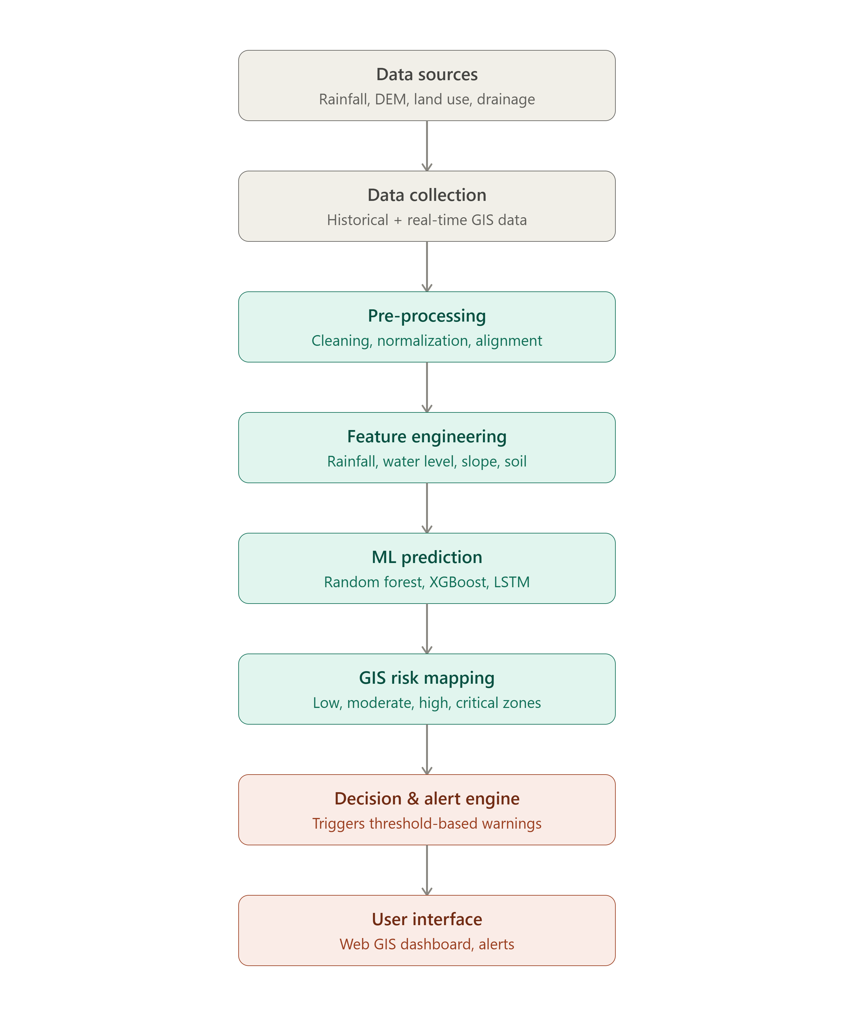
Architecture Diagram

Slide 9
Analysis of Problem Statement /Output Expected
Expected outcomes of this project:
Real-time urban flood risk classification (Low / Moderate / High / Critical) at a localized zone level
A trained ML model (Random Forest, XGBoost, LSTM) predicting flood probability from rainfall, elevation, drainage, and land-use data
GIS-based risk maps visualizing flood-prone zones across the city
A threshold-based decision and alert engine that triggers warnings for authorities and residents
A Web GIS dashboard displaying live risk maps, alerts, and historical trends

Slide 10
Analysis of Problem Statement (contd...)
Software and Hardware Requirements:
Software Requirements:
Python 3.x with scikit-learn, XGBoost, TensorFlow/Keras for model development
QGIS / ArcGIS for spatial data processing and DEM/land-use analysis
Flask or Django backend; React or Leaflet.js for the Web GIS dashboard
PostgreSQL with PostGIS extension for the spatial database
Jupyter Notebook / Google Colab for experimentation and model training

Slide 11
Analysis of Problem Statement (contd...)
Hardware Requirements:
Development machine: Intel i5/Ryzen 5 or higher, 8-16 GB RAM (GPU optional, for faster LSTM training)
Cloud or on-campus server for model deployment and dashboard hosting (AWS / GCP / Azure)
Minimum 50 GB storage for GIS datasets (DEM, satellite imagery, historical rainfall records)
Internet-enabled rain-gauge / IoT sensors for real-time data feed (proposed as future scope)

Slide 12
Timeline of the Project (Gantt Chart)
Phase | W1 | W2 | W3 | W4 | W5 | W6 | W7 | W8 | W9 | W10
Literature Survey & Requirement Analysis
Data Collection (rainfall, DEM, land use, drainage)
Data Preprocessing & Feature Engineering
ML Model Development & Training
GIS Risk Mapping Integration
Alert System & Dashboard Development
Testing & Validation
Documentation & Final Review

Slide 13
References (IEEE Paper format)
[1] “Evolution from the physical process-based approaches to machine learning approaches to predicting urban floods: a literature review,” Environmental Systems Research, Springer Nature, 2025.
[2] M. Motta, M. de Castro Neto, and P. Sarmento, “A mixed approach for urban flood prediction using machine learning and GIS,” International Journal of Disaster Risk Reduction, vol. 56, p. 102154, 2021.
[3] “A novel framework incorporating machine learning into GIS for flood susceptibility prediction of urban metro systems,” Science China Technological Sciences, 2025.
[4] “Assessment of flood susceptibilities in future urban renewal using machine learning incorporated into GIS,” ScienceDirect, 2026.
[5] S.-D. Jang, J.-H. Yoo, Y.-S. Lee, and B. Kim, “Flood prediction in urban areas based on machine learning considering the statistical characteristics of rainfall,” ScienceDirect, 2025.
[6] R. Abedi, R. Costache, H. Shafizadeh-Moghadam, and Q. B. Pham, “Flash-flood susceptibility mapping based on XGBoost, random forest and boosted regression trees,” Geocarto International, vol. 37, no. 19, pp. 5479–5496, 2022.
[7] H. Ren, B. Pang, P. Bai, G. Zhao, S. Liu, Y. Liu, and M. Li, “Flood Susceptibility Assessment with Random Sampling Strategy in Ensemble Learning,” Remote Sensing, vol. 16, no. 2, p. 320, 2024.
[8] S. T. Seydi, Y. Kanani-Sadat, M. Hasanlou, R. Sahraei, J. Chanussot, and M. Amani, “Comparison of Machine Learning Algorithms for Flood Susceptibility Mapping,” Remote Sensing, vol. 15, no. 1, p. 192, 2022.
[9] S. Mangkhaseum, Y. Bhattarai, S. Duwal, and A. Hanazawa, “Flood susceptibility mapping leveraging open-source remote-sensing data and machine learning approaches in Nam Ngum River Basin (NNRB), Lao PDR,” Geomatics, Natural Hazards & Risk, vol. 15, no. 1, 2024.
[10] “Generating the Flood Susceptibility Map for Istanbul with GIS-Based Machine Learning Algorithms,” Doğal Afetler ve Çevre Dergisi, 2024.
[11] Z. Demissie, P. Rimal, W. M. Seyoum, A. Dutta, and G. Rimmington, “Flood susceptibility mapping: Integrating machine learning and GIS for enhanced risk assessment,” Applied Computing and Geosciences, vol. 23, p. 100183, 2024.

Slide 14


